Slide 1
AENT – UNIT – II BUSINESS PLANNING & EXPLORING REVENUE

Slide 2
Contents:
Business Plan
Sales Plan
Hiring Sale Team
People Plan
Financial Planning
Financial Forecasting
Procurement Plan
Negotiating Role Play
Understanding Primary Revenue Sources
Exploring Customer Lifecycle for Growth Customers
Exploring and Identify Secondary Sources of Revenue

Slide 3
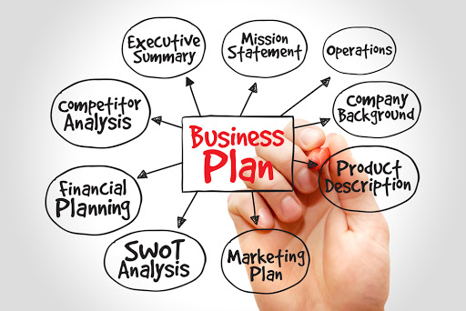

Slide 4
1. Business Plan
A business plan is a written document that describes in detail how a business — usually a startup — defines its objectives and how it is to go about achieving its goals. A business plan lays out a written roadmap for the firm from each of a sales, financial, and Human Resource planning.
Business plans are important documents used to attract investment before a company has established a proven track record. They are also a good way for companies to keep themselves on target going forward.

Slide 5
1. Business Plan
Types of Business Plans
Business plans help companies identify their objectives and remain on track. They can help companies start and manage themselves, and to help grow after they're up and running. They also act as a means to get people to work with and invest in the business.
Components of Business Plans
Executive summary
Business description and structure.
Market research and strategies.
Management and personnel.
Financial documents.

Slide 6


Slide 7
2. Sales Plan
Sales plans often include information about the business target customers, revenue goals, team structure, and the strategies and resources necessary for achieving its targets.
An effective sales plan should do the following:
Communicate your company’s goals and objectives to your sales team.
Provide strategic direction for your sales team.
Outline roles and responsibilities for your sales team and leadership.
Monitor your sales team’s progress to organizational goal

Slide 8


Slide 9
3. Hiring Sales Team:
companies need to hire sales teams that are multi-dimensional—salespeople who collaborate with others, help customers, use analytics, and work social media. With expert recruiting advice and the latest hiring trends, Monster Hiring Solutions can help your company find the best salespeople to grow your business.
Make Sure You're Actually Ready to Hire Commission Only Sales Reps.
Put Your Best Foot Forward.
Provide the Sales Training that Your Reps and Teams Need.
Explain Your Sales Process Clearly.
Create the Right Power Dynamic.

Slide 10
4. People Plan:
What Is Human Resource Planning (HRP)?
Human resource planning (HRP) is the continuous process of systematic planning ahead to achieve optimum use of an organization's most valuable asset—quality employees. Human resources planning ensures the best fit between employees and jobs while avoiding manpower shortages or surpluses.
There are four key steps to the HRP process. They include analyzing present labor supply, forecasting labor demand, balancing projected labor demand with supply, and supporting organizational goals. HRP is an important investment for any business as it allows companies to remain both productive and profitable.

Slide 11
4. People Plan:
Workforce or People Planning - Simple Steps. Workforce, or people planning, means identifying the strengths and skills you will need people to have, the work they will need to do, and when you will need them, to meet future objectives.
Strategies:
Treat your applicants well.
Think about the cost/benefit before your hire.
Try a freelancer.
Get potential employees with previous startup experience.
to strengthen your employer brand.
Use an employee referral program.

Slide 12
5. Financial Planning:
A financial plan is a document containing a person's current money situation and long-term monetary goals, as well as strategies to achieve those goals. A financial plan may be created independently or with the help of a certified financial planner.
In either case, it begins with a thorough evaluation of the individual's current financial state and future expectations.

Slide 13
5. Financial Planning:
Financial planning is a step-by-step approach to meet one’s life goals. A financial plan acts as a guide as you go through life’s journey. Essentially, it helps you be in control of your income, expenses and investments such that you can manage your money and achieve your goals.
If you take a closer look at the above examples, you’ll find that there is one factor that connects all of them: money. You need to have an adequate amount of money to fulfill your goals and desires. More importantly, you need to have money at the right point in time.
For example, if you want to build up a corpus of Rs. 10 lakh for your daughter’s college education through investments, you need to grow this amount by the time she turns 18. Not a year later. This is where financial planning becomes essential.

Slide 14
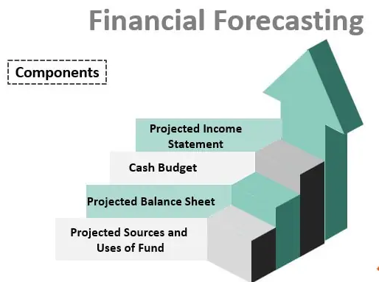

Slide 15
6. Financial Forecasting:
Financial Forecasting is the process of predicting or estimating future stats of an organization i.e. how business will perform in the future based on historical data like by analyzing the income statement, position statement, current conditions, past trends of the financial, future internal and external environment which is usually undertaken with the objective of preparing and developing budget and allocating available resources to ensure best possible utilization.

Slide 16
New Business Promotion – Financial forecasting helps businesses utilize its funds to promote new business ventures and initiatives. It also helps in determining the success rate of the business they are promoting.
Seamless Functioning– Accurate and effective forecasting of the finances like current revenue, revenue potential, and other expenses helps in the organization’s smooth running. The forecast also helps in anticipating future roadblocks.
Estimating Financial Requirements – It helps determine sales and cost of customer acquisition, capital for a specific project, and other expenses required for further management of the business. This preemptive forecast helps in making sound business decisions.
Control Cash Flow – It helps in controlling the cash flows of a business. Organizations with a good amount of cash/bank balance are more financially organized and better control their business operations.
Archive Overall Success – Financial forecast is important in achieving overall success for the business as it forms a strong foundation for the complete budgeting of departments across the organizations.

Slide 17
7. Procurement Plan
procurement plan -- also called a procurement management plan -- is a document that is used to manage the process of finding and selecting a vendor. The plan justifies the need for an external supplier and explains how the process of finding a supplier will be performed -- from identifying the project requirements to closing the contract.
The goal of a procurement plan is to increase the efficiency, effectiveness and transparency of the procurement process. The document specifically describes how products or services will be acquired and how vendors will be managed during the project. It includes information such as the types of contracts that will be used, the planned delivery or implementation dates for the contracted products or services, the types of metrics that will be used to evaluate the vendor's performance and an explanation of how the procurement process will be performed.
Creating a procurement plan helps an organization avoid surprises and last-minute considerations. The document helps leaders decide what to buy, when to buy it and what sources to purchase from. A procurement plan also allows project planners to determine if their expectations and requirements are realistic and can be completed in the proposed project timeline.

Slide 18
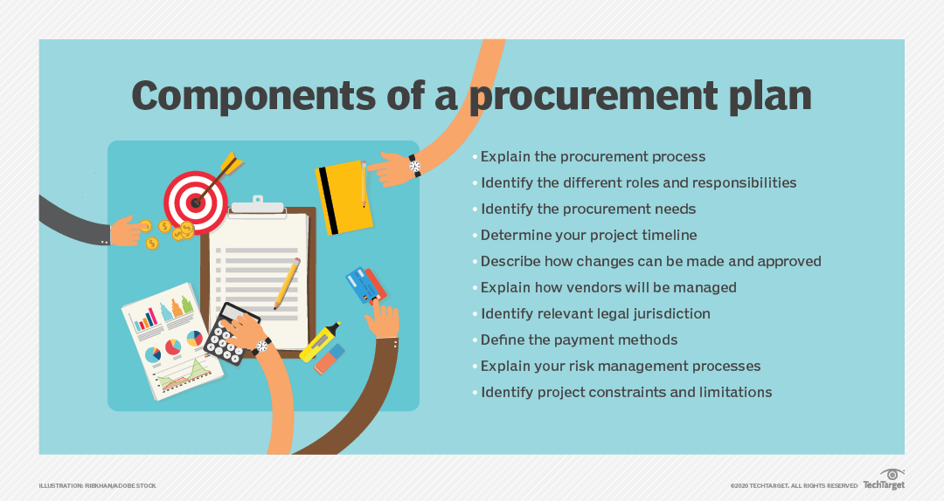

Slide 19
NEGOTIATING ROLE PLAY
>>>negotiation plays an important role in determining whether a customer purchases, and if so, at what price. A retailer may adopt negotiation
Negotiating skills for sales team people are crucial and improving them will set the foundation for a successful sale transaction
Guidelines:
Write down one personal area for improvement related to negotiating.
Choose who will play the salesperson and who will play the prospect. ...
Go through a standard negotiation. ...
After you come to an agreement or decide your needs are incompatible, debrief. ...
Switch roles

Slide 20
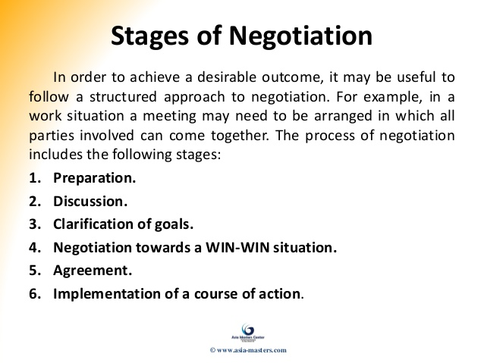

Slide 21
UNDERSTANDING PRIMARY REVENUE SOURCES
A revenue stream is a distinct source of income that can come from either be recurring revenue, transaction-based or service revenue. A business can have a single source of revenue or multiple sources depending on its business model
For any company, the primary revenue sources may be considered as the SALE of goods or services

Slide 22
EXPLORING CUSTOMER LIFECYCLE FOR GROWTH CUSTOMERS
In terms of customer relationship management, the customer lifecycle describes the various stages a consumer goes through before, during and after they complete a transaction. Simply put, it's the Point A to Point B journey a customer takes until they make the final purchase.
Life cycle management is a practice that can make or break your ability to upsell, cross-sell, and otherwise grow an existing customer relationship, and it helps companies cultivate brand loyalty by identifying opportunities for adding value to the customer equation at key points in time.

Slide 23
There five basic stages of a customer lifecycle:
Reach: Your marketing material and content needs to be in places where consumers will find it. Reach is the first step in the lifecycle because it develops awareness right away.
Acquire: Ecommerce acquisition is very important. Reaching potential customers won't mean much if you can't offer relevant content or messaging. Understanding your brand, the products you offer and what type of person will buy them will help with acquisition. Contacting them directly with personalized communication improves the odds of a future conversion.
Develop/nurture: Once that first purchase is made, your business needs to keep in contact with the customer. This is where you develop a relationship with the buyer, ensuring they're fully satisfied with their initial transaction. You can also use back-end analytics to predict what else they may like based on what they bought the first time around. Asking for feedback also helps develop the relationship; customers like that their opinion is valued.

Slide 24
Retention: If you're able to continually send relevant and meaningful messaging to a customer, the chances that they return and make another purchase are higher. Retention begins with satisfying a consumer's needs, caring for them and cultivating the relationship. If you can take a customer's feedback and use it to improve a product or service, you make them feel as if they were a part of the process. Performing a customer feedback analysis is key in finding actionable insights that can lead to a stronger customer relationship. This type of trust is valuable to customer retention.
Advocacy: Once the retention stage of the lifecycle is reached, you want these customers to become a brand advocate for your business. If they are truly satisfied, they likely won't have issues recommending your products or services to friends and family. Spreading awareness amongst social circles is easy to do once a customer is loyal to a brand, and if they continually spread positive recommendations, their extended network is more likely to convert as well.

Slide 25
EXPLORING AND IDENTIFY SECONDARY SOURCES OF REVENUE
Secondary revenue refers to revenue generated from goods or services which differ from the main product or service lines of a company. It may also be referred to as ancilliary or non-core revenue or as monetisation

Slide 26
THANK YOU

